Slide 1
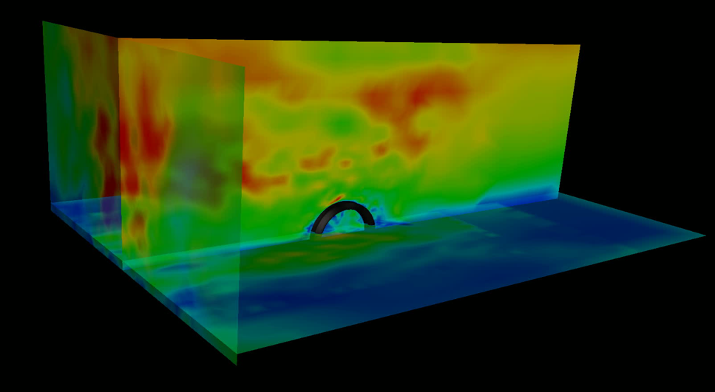
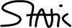
Chair of Structural Analysis
TUM Department of Civil, Geo and Environmental Engineering
Technical University of Munich
STRUCTURAL WIND ENGINEERING
Roland Wüchner, Chair of Structural Analysis, TUM
Máté Péntek, Chair of Structural Analysis, TUM
Structural Wind Engineering | Chair of Structural Analysis | WS 2019/20 | Detailed FSI

Slide 2
Presentation material from internal and external sources have been used either directly, modified or adapted to fit the purpose. Effort is continuously being made to accurately reference these. Nonetheless, check referencing in both the script as well as slides for completeness. In case of inconsistencies or mistakes please contact us!

Slide 3
Content
From CFD to FSI
FSI – EIE:buffeting-induced vibration
FSI – IIE: vortex shedding-induced vibration
From FSI with SDoF towards MDoF
FSI of multiple interfering bodies
Towards a generic CWSI case

Slide 4
FROM CFD TO FSI

Slide 5
All steps will be shown going from a conceptual and theoretical view to the preparation of an example. For each step there will be a collection of files and tasks provided for individual study.

Slide 6
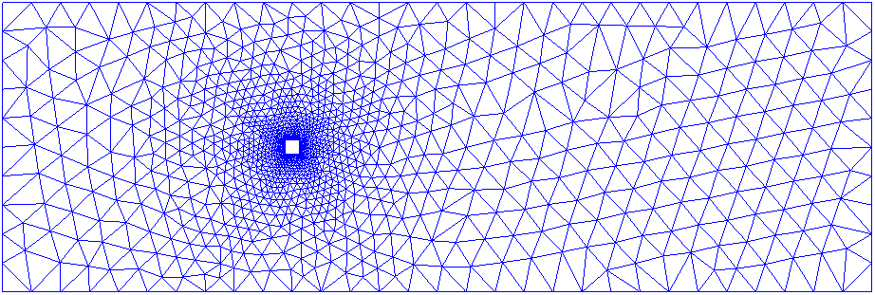
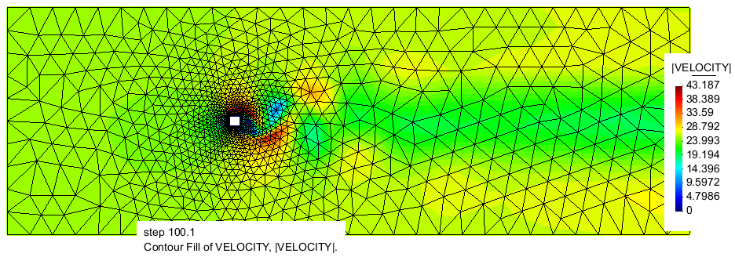
The steps necessery for going from CFD to FSI
2D CFD example ⇒ representing a horizontal cut through a building
2D FSI example ⇒ representing model scenario for gust-induced buffeting
Inlet
Prescribed velocity
CFD setup
CFD simulation results
Wall
Slip-condition
Structure
Non-moving
No slip condition
Fluid
Navier-Stokes
Fractional-step solver
Outlet
Assigned pressure
FSI setup
Inlet
Prescribed velocity
Varying in time
Oscillating parabola
Structure
No slip condition
Moving
SDoF solver

Slide 7
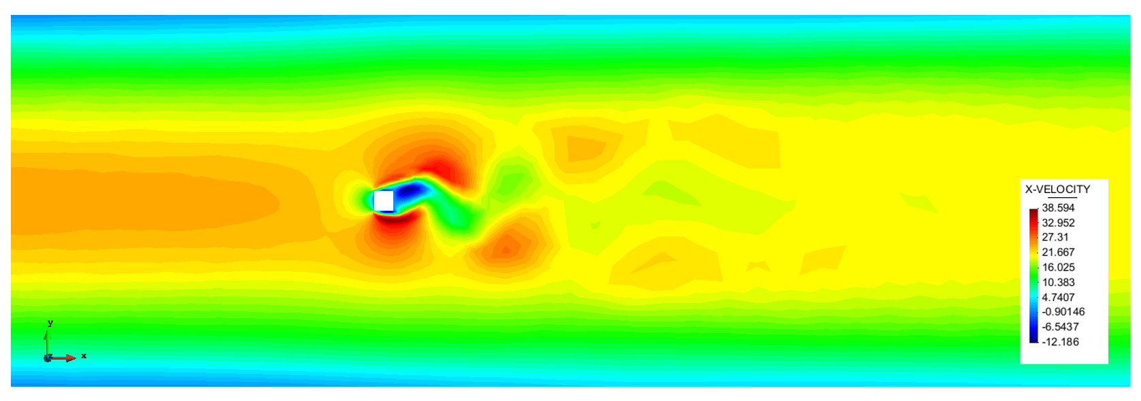
Custom inlet
From constant in time and space ⇒ varying in time and space: case of a pulsating inlet.
CFD setup
Custom inlet
Structural solver
Mesh mover
Coupling of physics and numerics
Power law
Constant
Constant parabolic
FSI setup

Slide 8
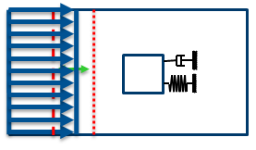
Structural solver
The Generalized Alpha solver for SDoF ⇒ provided in the SDoF Python solver
k
m
f(t) = f₀ e^{iωt} = a cos(ωt) + b sin(ωt)
CFD setup
c_{v}
l₀
x
Custom inlet ✓
Structural solver
Mesh mover
Coupling of physics and numerics
x(t)
f ω_{n} / 2k
₀
2πω_{n}
6πω_{n}
10πω_{n}
t
πω_{n}
4πω_{n}
8πω_{n}
FSI setup

Slide 9
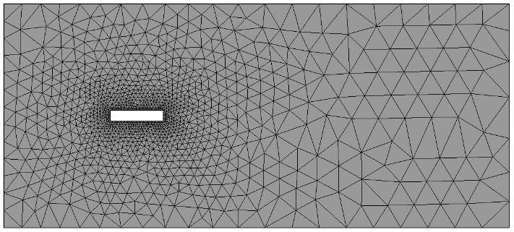
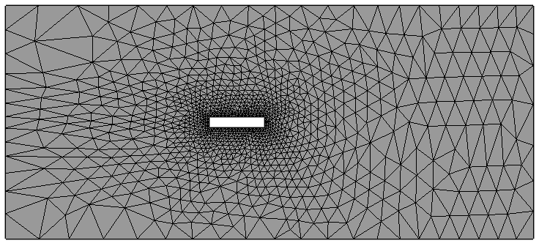
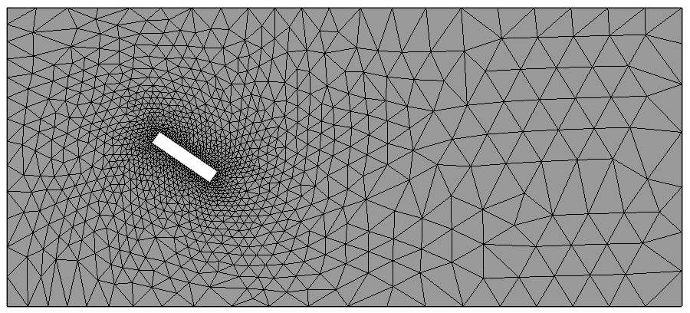
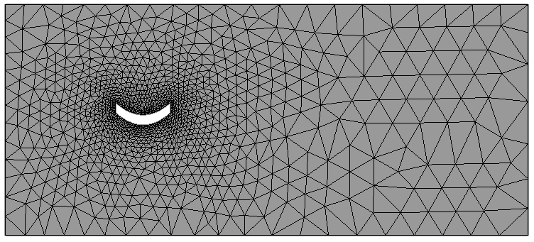
Mesh mover
Example initial CFD mesh
Possible movement
Translation
Rotation
Bending
CFD setup
Custom inlet ✓
Structural solver ✓
Mesh mover
Coupling of physics and numerics
FSI setup

Slide 10
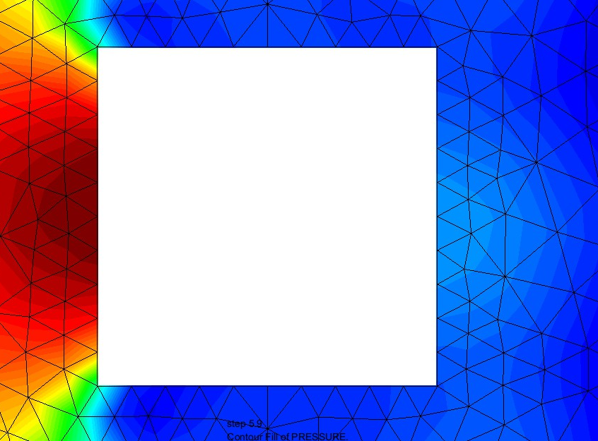
Coupling of physics D-N
Fluid solver ⇒ solves at timestep ⇒ pressure and friction on structure ⇒ forces on surface nodes ⇒ passed to structural solver as input
Structural solver ⇒ SDoF solver for given forces reduced into center of gravity – Neumann condition for structure
CFD setup
Custom inlet ✓
Structural solver ✓
Mesh mover ✓
Coupling of physics and numerics
FSI setup
k
m
c_{v}
l₀
x

Slide 11
Coupling of physics D-N
Structural solver ⇒ SDoF solver results a displacement X
Mesh solver ⇒ receives displacement as input from structural solver ⇒ solves ⇒ send the calculated mesh velocity to the fluid solver
Fluid solver ⇒ takes the velocity input as Dirichlet condition ⇒ solves
⇒ The iteration loop goes on until a convergence criteria is met ⇒ refer back to the stong coupling for FSI problems
k
m
c_{v}
CFD setup
l₀
x
Custom inlet ✓
Structural solver ✓
Mesh mover ✓
Coupling of physics and numerics
FSI setup

Slide 12
FSI – EIE: BUFFETING-INDUCED VIBRATION

Slide 13
FSI – buffeting tutorial
Based up on Tutorial 4 ⇒ StructWindEng_WS1920_GiDKratosTutorial1_2D_CFD
2D FSI example representing a horizontal cut through a building
Please make the modifications to the files in this example

Slide 14
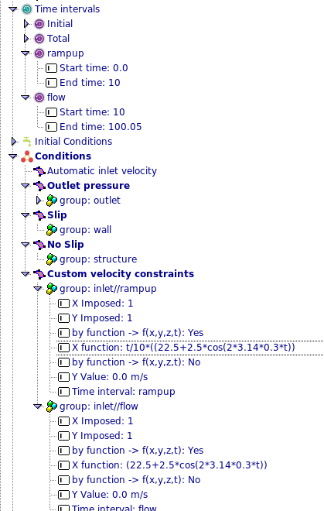
FSI – buffeting tutorial
Open with GiD the file you created on SWE_WS1920_GiDKratosTutorial1_2D_CFD
Apply an oscillating inlet velocity and ramp up time of 10 sec
Save as a new file
copy the contents of the folder “FSISDoFBuffeting” from “AuxiliaryFiles”
Rename “ProjectParameters.json” to “ProjectParametersCFD.json”
Copy “solver_settings” block from the “ProjectParametersCFD.json” Template
( check the next slide for picture)
open “ProjectParametersFSI.json” and check “interface_submodel_part” matches the name given to your structural model part
run “MainKratosFSI.py”

Slide 15
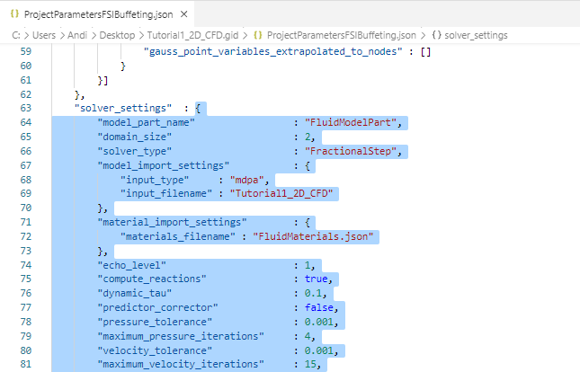
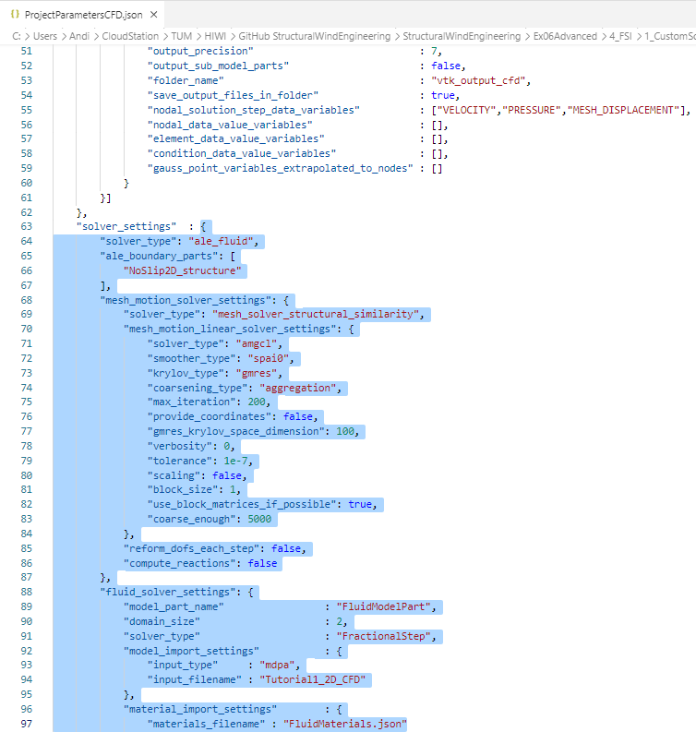
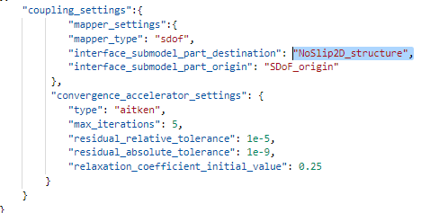
FSI – buffeting tutorial
ProjectParameters.json
ProjectParametersCFD.json Template
ProjectParametersFSI.json

Slide 16
FSI – IIE: VORTEX SHEDDING-INDUCED VIBRATION

Slide 17
FSI – vortex shedding-induced vibration tutorial
Based up on Tutorial 4 ⇒ SWE_WS1920_GiDKratosTutorial1_2D_CFD
2D FSI example representing a horizontal cut through a building
Please make the modifications to the files in this example

Slide 18
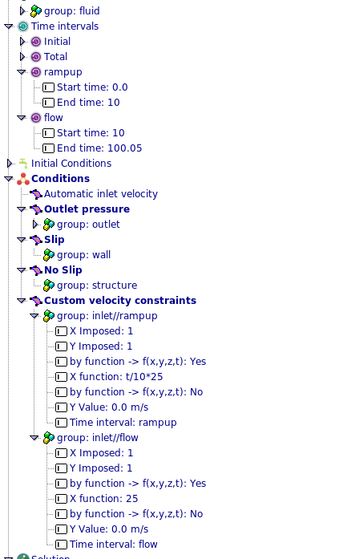
FSI – vortex shedding-induced vibration tutorial
Open with GiD the file you created on SWE_WS1920_GiDKratosTutorial1_2D_CFD
Apply a constant inlet velocity and ramp up time of 10 sec
Save as a new file
copy the contents of the folder “FSISDoFVortexShedding” from “AuxiliaryFiles”
Rename “ProjectParameters.json” to “ProjectParametersCFD.json”
Copy “solver_settings” block from the “ProjectParametersCFD.json” Template
( check the next slide for picture)
open “ProjectParametersFSI.json” and check “interface_submodel_part” matches the name given to your structural model part
run “MainKratosFSI.py”

Slide 19

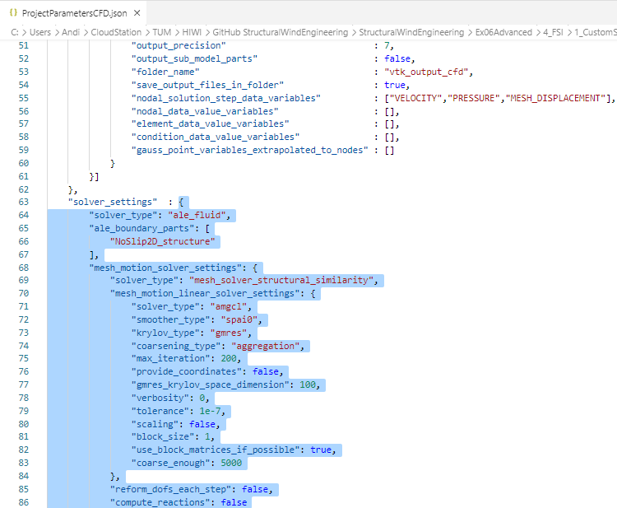
FSI – buffeting tutorial
ProjectParameters.json
ProjectParametersCFD.json Template
ProjectParametersFSI.json

Slide 20
FROM FSI WITH SDOF TOWARDS MDOF

Slide 21
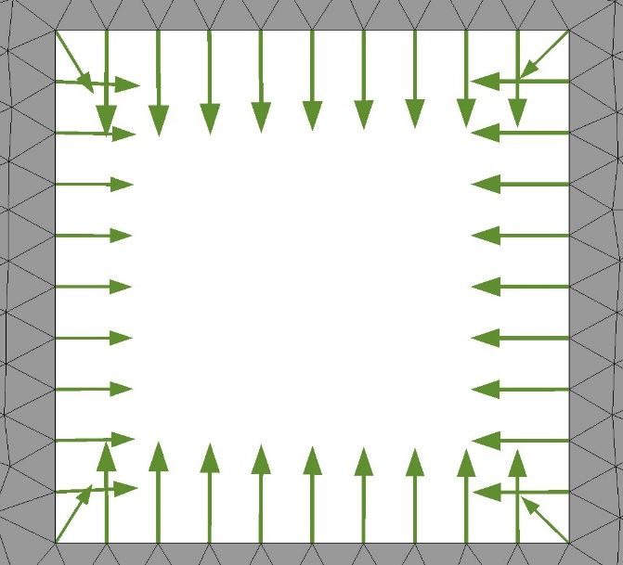
Case of 3 x SDoF = MDoF
Reaction magnitude
(0,0)
Nodal reactions from the CFD
Concentrated action on the SDoF ⇒ here the MDoF can be seen and simplified into a superposition of SDoFs ⇒ a 3SDoF
A superposition of SDoFs ⇒ displacement_X + displacement_Y + rotation
Each SDoF
⇒ concentrated into a material point (to (0,0))
⇒ no shape + no dimension!

Slide 22
FSI – 3SDoF tutorial
Based up on Tutorial 4 ⇒ SWE_WS1920_GiDKratosTutorial1_2D_CFD
Open with GiD the file you created on SWE_WS1920_GiDKratosTutorial1_2D_CFD
Apply a constant inlet velocity and ramp up time of 10 sec
Save as a new file
copy the contents of the folder “FSI3SDoF from “AuxiliaryFiles”
Rename “ProjectParameters.json” to “ProjectParametersCFD.json”
Copy “solver_settings” block from the “ProjectParametersCFD.json” Template
open “ProjectParametersFSI.json” and check “interface_submodel_part” matches the name given to your structural model part
run “MainKratosFSI.py”

Slide 23


FSI – 3SDoF tutorial
ProjectParameters.json
ProjectParametersCFD.json Template
ProjectParametersFSI.json

Slide 24
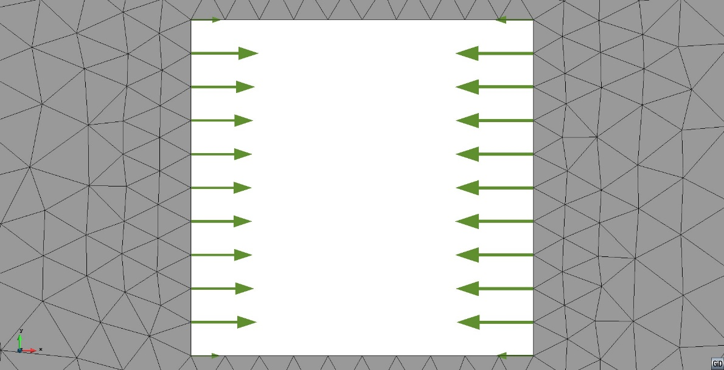
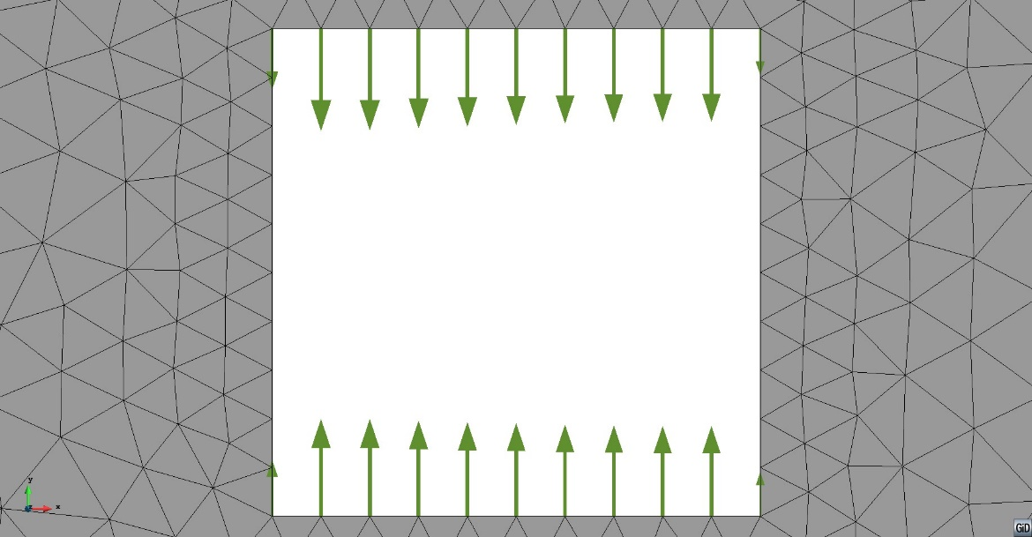
Case of 3 x SDoF = MDoF
Reaction X
Reaction Y
Reaction magnitude
Reaction ⇒ result of the CFD simulation, here 2D case of horizontal cut ⇒ reaction extraction and „preparing/sending“ to the SDoF solver
Locate structure interface in fluid domain
Loop over the nodes on the interface
Extract reactions from the nodes

Slide 25
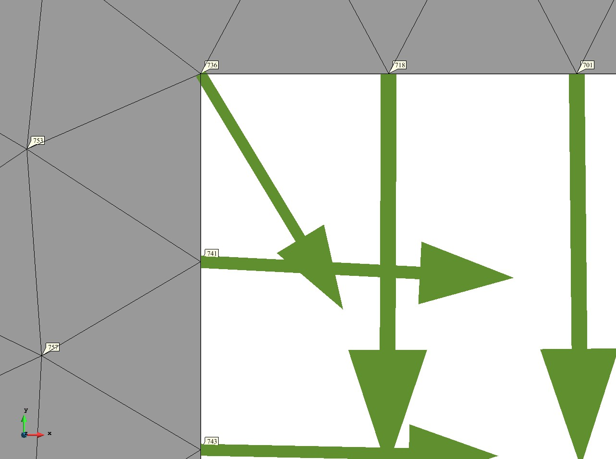
Case of 3 x SDoF = MDoF
Reaction magnitude
Node
Coordinates: node.X, node.Y, node.Z
Id number: node.Id
Nodal data: pressure, velocity, reaction, displacement
Retrieving nodal solutions – from the current time step using the commands:
node.GetSolutionStepValue(PRESSURE, 0)
node.GetSolutionStepValue(VELOCITY, 0)
node.GetSolutionStepValue(REACTION, 0)
node.GetSolutionStepValue(MESH_DISPLACEMENT, 0)
Interested in nodes on the interface of the structure ⇒ nodes part of a certain Sub Model Part
for node in main_model_part.GetSubModelPart(structure_submodel).Nodes

Slide 26
Case of 3 x SDoF = MDoF
Some selected code snippets
Compare: fsi_utilities.py: lines 84-111
Extract and apply appropriate action force for
⇒ displacement_X
⇒ displacement_Y
⇒ rotation
def NeumannToStructure(mapper, structure_solver, flag): multiplicator = 1.0
# if swap_sign:
if flag:
multiplicator = -1.0
fx = 0.0
fy = 0.0
mz = 0.0
for node in mapper.destination_interface.Nodes:
reaction = node.GetSolutionStepValue(
KratosMultiphysics.REACTION, 0)
fx += multiplicator * reaction[0]
fy += multiplicator * reaction[1]
fx_n = multiplicator * reaction[0]
fy_n = multiplicator * reaction[1]
rx_n = node.X - current_center_x
ry_n = node.Y - current_center_y
mz += ry_n * fx_n - rx_n * fy_n
structure_solver.SetExternalForce([fx, fy, mz])

Slide 27
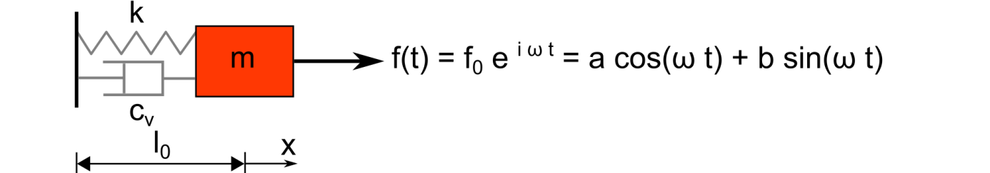
Case of 3 x SDoF = MDoF
Solve for each structural solver separately
Compare : MainKratosFSI.py: lines 225-234
Calculate the DoFs using the respective structural solver for
⇒ displacement_X
⇒ displacement_Y
⇒ rotation
fsi_utilities.NeumannToStructure(mapper, structural_solver, True)
# # Solver Structure
structural_solver.SolveSolutionStep()
Set displacement to the nodes on the surface of the structure ⇒ as a superposition of SDoFs
Compare: fsi_utilities.py: lines 114-134
def DisplacementToMesh(mapper, displacement, structure_solver):
disp_x = displacement[0]
disp_y = displacement[1]
theta = displacement[2]
for node in mapper.destination_interface.Nodes:
rx0 = node.X0 - current_center_x
ry0 = node.Y0 - current_center_y
rx = math.cos(theta) * rx0 + math.sin(theta) * ry0
ry = - math.sin(theta) * rx0 + math.cos(theta) * ry0
dx = rx - rx0 + disp_x
dy = ry - ry0 + disp_y
node.SetSolutionStepValue(
KratosMultiphysics.MESH_DISPLACEMENT_X, dx)
node.SetSolutionStepValue(
KratosMultiphysics.MESH_DISPLACEMENT_Y, dy)

Slide 28
Case of 3 x SDoF = MDoF: important code snippets highlighted
Residuals for each DoF combined in a vector ⇒ vector norm checked for convergence
Compare : MainKratosFSI.py: lines 236-272
# Convergence Checking (only for implicit coupling)
if convergence_accelerator.max_iter > 1:
displacements = fsi_utilities.GetDisplacements(structural_solver)
# Compute Residual
old_residual = residual
residual = convergence_accelerator.CalculateResidual(
displacements, old_displacements)
if (fsi_utilities.Norm(residual) <= convergence_accelerator.res_rel_tol):
fsi_utilities.SetDisplacements(displacements, structural_solver)
print("************ CONVERGENCE AT INTERFACE ACHIEVED *******")
else:
relaxation_coefficient = convergence_accelerator.ComputeRelaxationCoefficient(
relaxation_coefficient, residual, old_residual, k)
relaxed_displacements = convergence_accelerator.CalculateRelaxedSolution(
relaxation_coefficient, old_displacements, residual)
old_displacements = relaxed_displacements
fsi_utilities.SetDisplacements(relaxed_displacements, structural_solver)
num_inner_iter += 1
if (k+1 >= convergence_accelerator.max_iter):
print("##### CONVERGENCE AT INTERFACE WAS NOT ACHIEVED ######")
print("COUPLING RESIDUAL = ", fsi_utilities.Norm(residual))
print("COUPLING ITERATION = ", k+1, "/", convergence_accelerator.max_iter)
print("RELAXATION COEFFICIENT = ", relaxation_coefficient)
Get vector with results
Compute the initial residual
Check if convergence achieved
Iterate between fluid and structure until convergence or max. Iterations reached

Slide 29
FSI OF MULTIPLE INTERFERING BODIES
[B. Chandra, H. L. Weng, S.v. Wenczowski, M. Péntek, A. Winterstein: Partitioned Multi-Physics Simulation of Interfering Square Cylinders in a Flow, FEM for FSI project, Statik TUM, 2017]

Slide 30
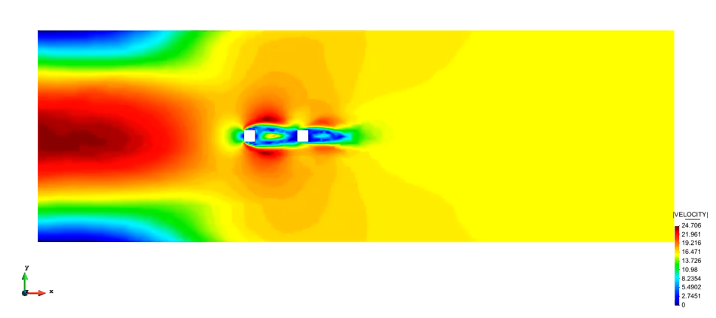
FSI: modeling of multiple interfering bodies
Open in GiD postprocess Version1 and Version2 results from “ FSIInterfering“

Slide 31
TOWARDS A GENERIC FSI CASE

Slide 32
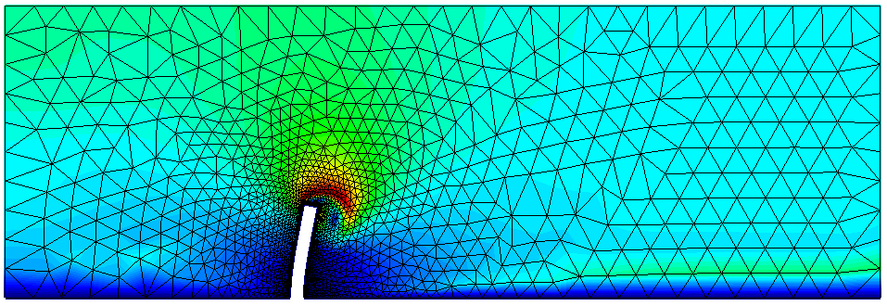
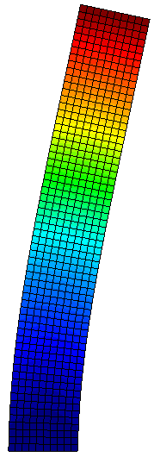
Differences compared to the example of the horizontal cut
Structural solver ⇒ A generalized MDoF solver (X and Y displacement possible for each node of the structure ) ⇒ FEM formulation
Coupling of physics and numerics
⇒ using matching grids: each node of the interface of the structure has a corresponding node (with the same coordinates) in the fluid domain
⇒ the forces of the fluid are not reduced to a certain point (previously center of gravity), but passed to the corresponding node in the structural solver
⇒ vectorial formulation of the residual for convergence
⇒ Fix-point and Aitken relaxation
CFD setup
Custom inlet ✓
Structural solver ✓
Mesh mover ✓
Coupling of physics and numerics ✓
Fluid
domain
Structure
domain
FSI setup

Slide 33
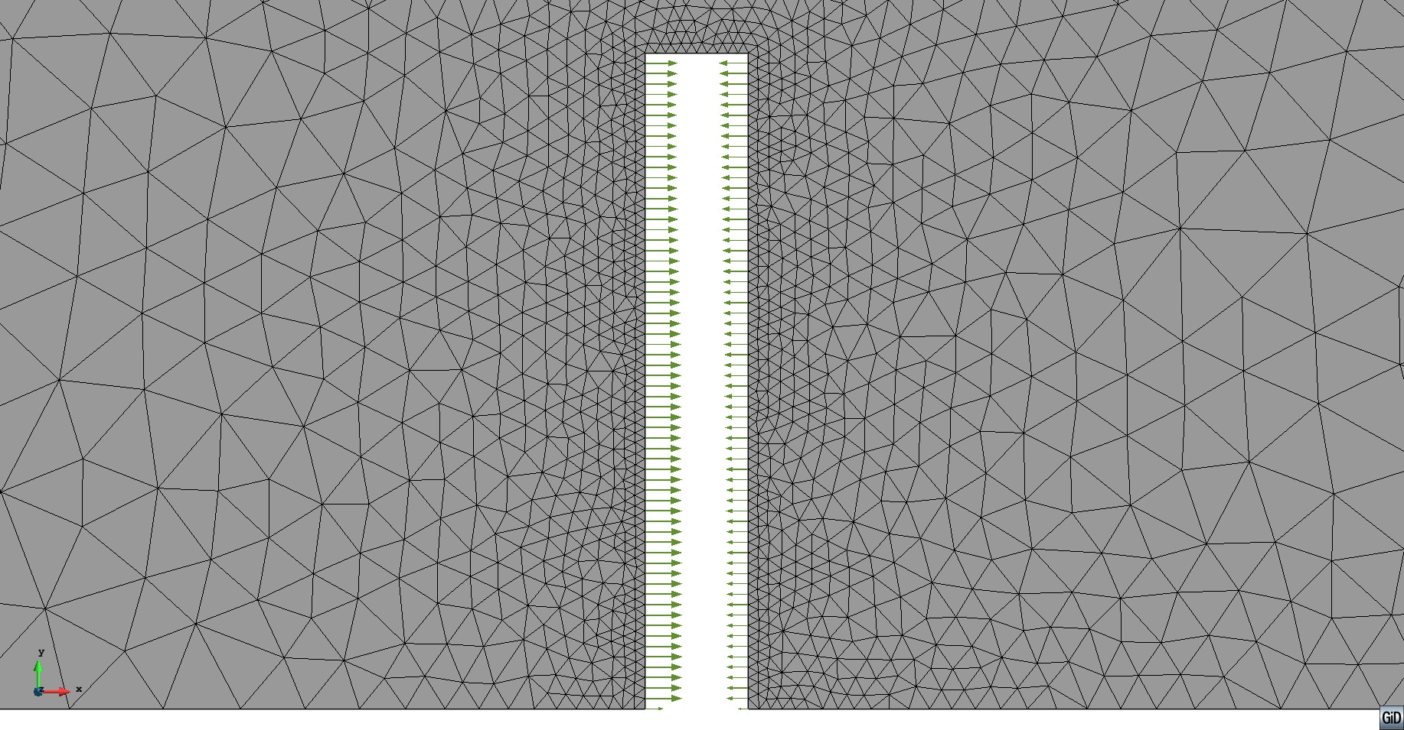
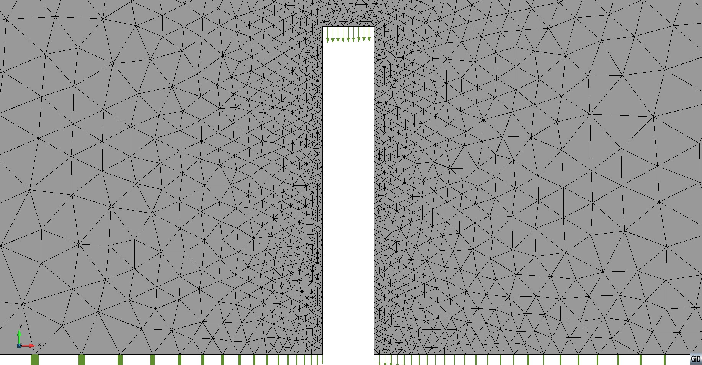
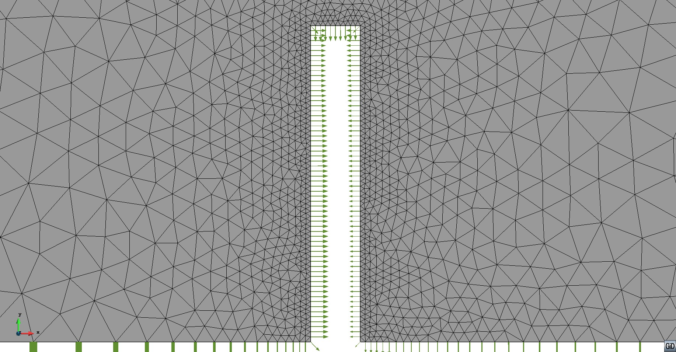
FSI: Kratos CFD + Kratos CSD coupling – MDoF/general FEM case
Reaction X
Reaction Y
Reaction ⇒ result of the CFD simulation, here 2D case of vertical cut ⇒ reaction extraction and „preparing/sending“ to the structural (generalized MDoF/FEM) solver
Locate structure interface in fluid domain
Loop over the nodes on the interface
Extract reactions from the nodes

Slide 34
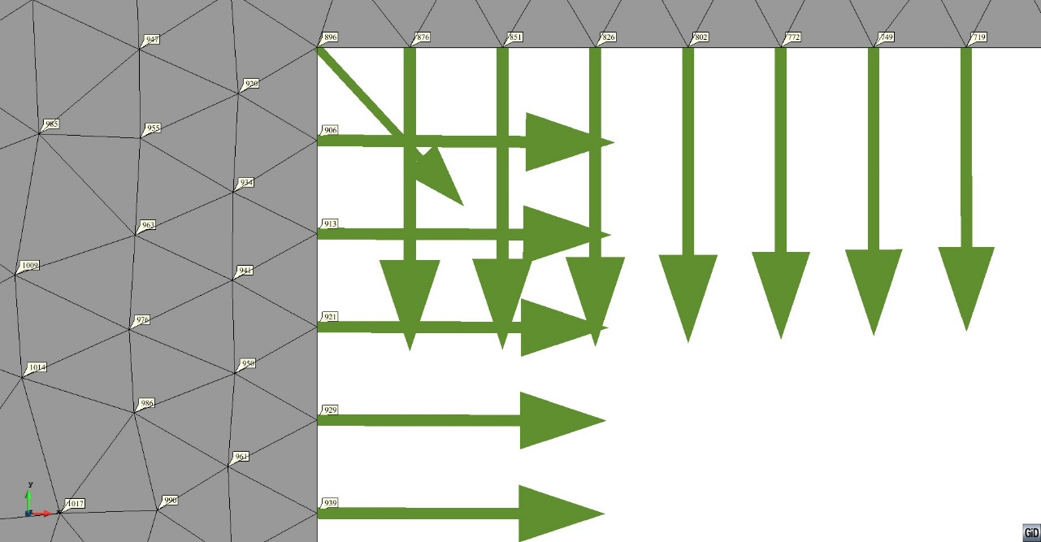
Kratos CFD + Kratos CSD coupling – MDoF/general FEM case
Reaction magnitude
Node
Coordinates: node.X, node.Y, node.Z
Id number: node.Id
Nodal data: pressure, velocity, reaction, displacement
Retrieving nodal solutions – from the current time step using the commands:
node.GetSolutionStepValue(PRESSURE, 0)
node.GetSolutionStepValue(VELOCITY, 0)
node.GetSolutionStepValue(REACTION, 0)
node.GetSolutionStepValue(DISPLACEMENT, 0)
Interested in nodes on the interface of the structure ⇒ nodes part of a certain Submodel Part
for node in main_model_part_fluid.GetSubModelPart(structure) .Nodes:

Slide 35

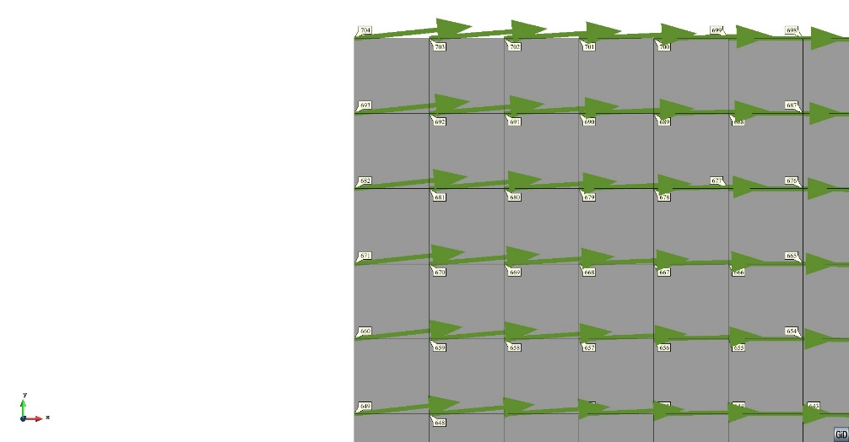
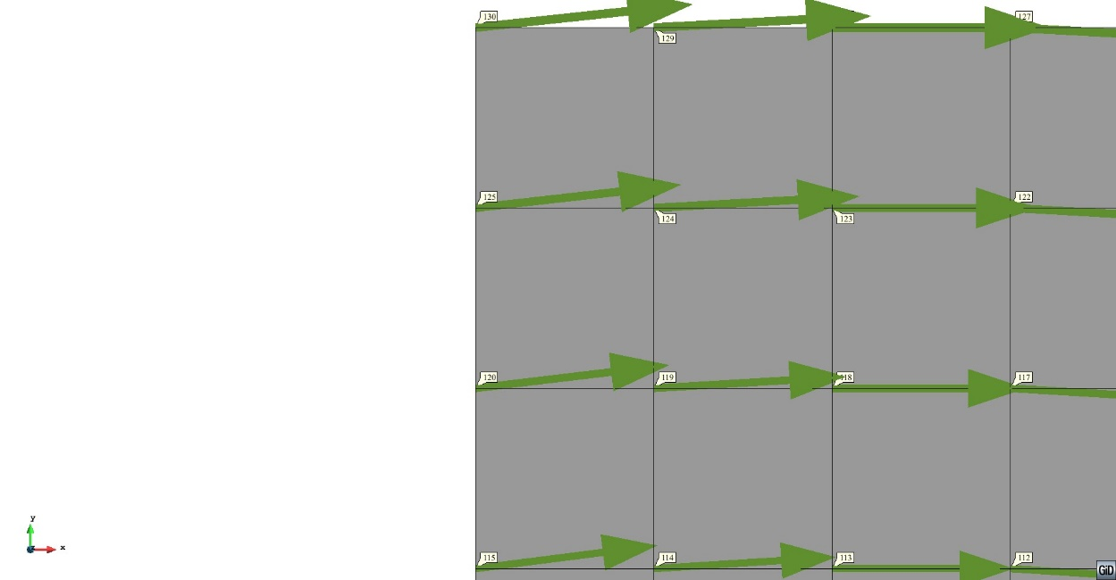
Kratos CFD + Kratos CSD coupling – MDoF/general FEM case
5 x 3.0 = 15.0
5 x 3.0 = 15.0
5 x 3.0 = 15.0
5 x 3.0 = 15.0
CFD – Reaction magnitude
⇒ needs to be „communicated/sent” to the structural solver
⇒ mesh size on the structure interface of the CFD domain is 3.0
2 x 7.5 = 15.0
CSD – Displacement magnitude
⇒ needs to be „communicated/sent” to the fluid (or mesh) solver
⇒ mesh size on the structure interface of the CSD domain is 3.0 (matching) and 7.5 (non-matching)
2 x 7.5 = 15.0

Slide 36
Kratos CFD + Kratos CSD coupling ⇒ matching grid
CFD – Reaction magnitude
⇒ needs to be „communicated/sent” to the structural solver
⇒ mesh size on the structure interface of the CFD domain is 3.0
CSD – Displacement magnitude
⇒ needs to be „communicated/sent” to the fluid (or mesh) solver
⇒ mesh size on the structure interface of the CSD domain is 3.0 (matching the one on the CFD side)
Matching nodes on interface ⇒ needs a searching, matching and storing algorithm for pairing nodes

Slide 37
Kratos CFD + Kratos CSD coupling ⇒ matching grid: important code snippets highlighted
Find matching fluid and structure nodes ⇒ must have approx. the same coordinates
Loop over all possible combinations of fluid and structure nodes at the interface
for fluid_node in structure_interface.Nodes:
for struct_node in fluid_interface.Nodes:
if (abs(fluid_node.X - struct_node.X) < 1e-4) and (abs(fluid_node.Y - struct_node.Y) < 1e-4):
fluid_node.SetValue(PATCH_INDEX, struct_node.Id)
struct_node.SetValue(PATCH_INDEX, fluid_node.Id)
If the nodes of a combination have approx. the same coordinates ⇒ set them as a matching pair for FSI

Slide 38
Kratos CFD + Kratos CSD coupling ⇒ matching grid: important code snippets highlighted
Apply forces from fluid on structure
Compare: MainKratosFSI lines 243-249 and fsi_utilities lines 84-111
# Apply Neumann B.C.'s from fluid solver to structural solver
# inverse map from the nodes in the fluid (destination) on the interface
## KratosMultiphysics.REACTION
# to the interface nodes on the structure (origin) with sign swap
## KratosStructuralMechanics.POINT_LOAD
fsi_utilities.NeumannToStructure(mapper, structural_solver, True)
def NeumannToStructure(mapper, structure_solver, flag):
mapper.InverseMap(KratosStructuralMechanics.POINT_LOAD, KratosMultiphysics.REACTION, flag)
structure_solver.SetExternalForce([fx, fy, mz])
Apply displacements of structure on fluid mesh
Compare: MainKratosFSI.py: lines 222-229 and fsi_utilities lines 114-134
# Apply Dirichlet B.C.'s from structural solver to mesh solver
# map from the nodes in the structure (origin) on the interface
## KratosStructuralMechanics.POINT_LOAD
# to the interface nodes on the fluid (destination)
## KratosMultiphysics.MESH_DISPLACEMENT
# fsi_utilities.DisplacementToMesh(mapper)
fsi_utilities.DisplacementToMesh(mapper, old_displacements, structural_solver)
def DisplacementToMesh(mapper, displacement, structure_solver):
mapper.Map(KratosMultiphysics.DISPLACEMENT, KratosMultiphysics.MESH_DISPLACEMENT)
for node in mapper.destination_interface.Nodes:
node.SetSolutionStepValue(KratosMultiphysics.MESH_DISPLACEMENT_X, dx)
node.SetSolutionStepValue(KratosMultiphysics.MESH_DISPLACEMENT_Y, dy)

Slide 39
Kratos CFD + Kratos CSD coupling ⇒ non-matching grid
CFD – Reaction magnitude
⇒ needs to be „communicated/sent” to the structural solver
⇒ mesh size on the structure interface of the CFD domain is 3.0
CSD – Displacement magnitude
⇒ needs to be „communicated/sent” to the fluid (or mesh) solver
⇒ mesh size on the structure interface of the CSD domain is 3.0 (matching the one on the CFD side)
Matching nodes on interface ⇒ needs a searching, matching and storing algorithm for pairing nodes

Slide 40
Kratos CFD + Kratos CSD coupling ⇒ non-matching grid
Nodes on the interface – CFD domain
Nodes on the interface
– CSD domain
Assumption:
CFD mesh finer than
CSD on the interface
CFD – Reaction magnitude
⇒ needs to be „communicated/sent” to the structural solver
⇒ mesh size on the structure interface of the CFD domain is 3.0
CSD – Displacement magnitude
⇒ needs to be „communicated/sent” to the fluid (or mesh) solver
⇒ mesh size on the structure interface of the CSD domain is 7.5 (not matching the one on the CFD side)
Non-matching nodes on interface ⇒ each fluid node is connected to the closest 2 structural nodes ✓

Slide 41
Kratos CFD + Kratos CSD coupling ⇒ non-matching grid
F_{b}
R_{b}
Action/point load on the structure seen as a distance weighted value of the reaction of the fluid
F_{b} = F * w_{b} = F * a / (a+b)
F_{a} = F * w_{a} = F * b / (a+b)
⇒ analogy with the point load on a simply supported beam
⇒ structure nodes and respective weights (wa, wb) for each fluid node on the interface have to be searched for, computed and stored
⇒ one way of data transformation between different discretizations
b
F
F
L = a+b
a
F_{a}
R_{a}
Non-matching nodes on interface ⇒ each fluid node is connected to the closest 2 structural nodes ✓

Slide 42
Kratos CFD + Kratos CSD coupling ⇒ non-matching grid
F_{b}
R_{b}
Action/point load on the structure seen as a distance weighted value of the reaction of the fluid
F_{b} = F * w_{b} = F * a / (a+b)
F_{a} = F * w_{a} = F * b / (a+b)
⇒ analogy with the point load on a simply supported beam
b
F
F
L = a+b
a
F_{a}
Ra
Disp_X_{b}
Displacement of the nodes on the structural interface of the CSD solver sent to the paired node on the fluid side
⇒ linear interpolation of the displacements Disp_X_{b} and Disp_X_{a} for the node of the fluid mesh
Disp_X_{ab} = Disp_X_{b} * w_{b} +
Disp_X_{a} * w_{a}
⇒ using the respective weights (wa, wb) already calculated and stored
b
Disp_X_{ab}
L = a+b
a
Disp_X_{a}
Non-matching nodes on interface ⇒ each fluid node is connected to the closest 2 structural nodes ✓

Slide 43
Kratos CFD + Kratos CSD coupling ⇒ non-matching grid: important code snippets highlighted
Apply forces from fluid on structure
Compare: fsi_utilities.py lines 235-431
def InverseMap(self, origin_variable, destination_variable, swap_sign):
origin_var_name = origin_variable.Name()
origin_var_comp_x = KratosMultiphysics.KratosGlobals.GetVariable(origin_var_name + "_X")
origin_var_comp_y = KratosMultiphysics.KratosGlobals.GetVariable(origin_var_name + "_Y")
for destination_node in self.destination_interface.Nodes:
coupling_for_destination_node = self.coupling_matrix[destination_node.Id]
node_1_id = coupling_for_destination_node[0]
node_2_id = coupling_for_destination_node[1]
node_1_w = coupling_for_destination_node[2]
node_2_w = coupling_for_destination_node[3]
val_comp_x = multiplicator * destination_node.GetSolutionStepValue(destination_var_comp_x, 0)
val_comp_y = multiplicator * destination_node.GetSolutionStepValue(destination_var_comp_y, 0)
origin_node_1_val_comp_x = val_comp_x * node_1_w
origin_node_1_val_comp_y = val_comp_y * node_1_w origin_node_2_val_comp_x = val_comp_x * node_2_w
origin_node_2_val_comp_y = val_comp_y * node_2_w
origin_node_1_val_comp_x += self.origin_interface.Nodes[node_1_id].GetSolutionStepValue(origin_var_comp_x, 0)
origin_node_1_val_comp_y += self.origin_interface.Nodes[node_1_id].GetSolutionStepValue(origin_var_comp_y, 0)
origin_node_2_val_comp_x += self.origin_interface.Nodes[node_2_id].GetSolutionStepValue(origin_var_comp_x, 0)
origin_node_2_val_comp_y += self.origin_interface.Nodes[node_2_id].GetSolutionStepValue(origin_var_comp_y, 0)
self.origin_interface.Nodes[node_1_id].SetSolutionStepValue(origin_var_comp_x, 0, origin_node_1_val_comp_x)
self.origin_interface.Nodes[node_1_id].SetSolutionStepValue(origin_var_comp_y, 0, origin_node_1_val_comp_y) self.origin_interface.Nodes[node_2_id].SetSolutionStepValue(origin_var_comp_x, 0, origin_node_2_val_comp_x)
self.origin_interface.Nodes[node_2_id].SetSolutionStepValue(origin_var_comp_y, 0, origin_node_2_val_comp_y)
Get point_loads
get corresponding two structure nodes and weights (stored in CouplingMatrix)
get the reaction force from the fluid node
compute the resulting reaction forces on the structure nodes
add the forces already subjected from other fluid nodes
set the summmed up forces on the nodes

Slide 44
Kratos CFD + Kratos CSD coupling ⇒ non-matching grid: important code snippets highlighted
Apply displacements of structure on fluid mesh
Compare: fsi_utilities.py: lines 294-330
def Map(self, origin_variable, destination_variable):
for destination_node in self.destination_interface.Nodes:
coupling_for_destination_node = self.coupling_matrix[destination_node.Id]
node_1_id = coupling_for_destination_node[0]
node_2_id = coupling_for_destination_node[1]
node_1_w = coupling_for_destination_node[2]
node_2_w = coupling_for_destination_node[3]
origin_node_1_val_comp_x = self.origin_interface.Nodes[node_1_id].GetSolutionStepValue(origin_var_comp_x, 0)
origin_node_1_val_comp_y = self.origin_interface.Nodes[node_1_id].GetSolutionStepValue(origin_var_comp_y, 0)
origin_node_2_val_comp_x = self.origin_interface.Nodes[node_2_id].GetSolutionStepValue(origin_var_comp_x, 0)
origin_node_2_val_comp_y = self.origin_interface.Nodes[node_2_id].GetSolutionStepValue(origin_var_comp_y, 0)
destination_node_val_comp_x = origin_node_1_val_comp_x * node_1_w + origin_node_2_val_comp_x * node_2_w
destination_node_val_comp_y = origin_node_1_val_comp_y * node_1_w + origin_node_2_val_comp_y * node_2_w
destination_node.SetSolutionStepValue(destination_var_comp_x, 0, destination_node_val_comp_x)
destination_node.SetSolutionStepValue(destination_var_comp_y, 0, destination_node_val_comp_y)
loop over all fluid nodes at interface
get corresponding two structure nodes and weights (stored in CouplingMatrix)
get the displacements of both structure nodes
compute the fluid node displacement by interpolation using the weights
set the displacement of the fluid node

Slide 45
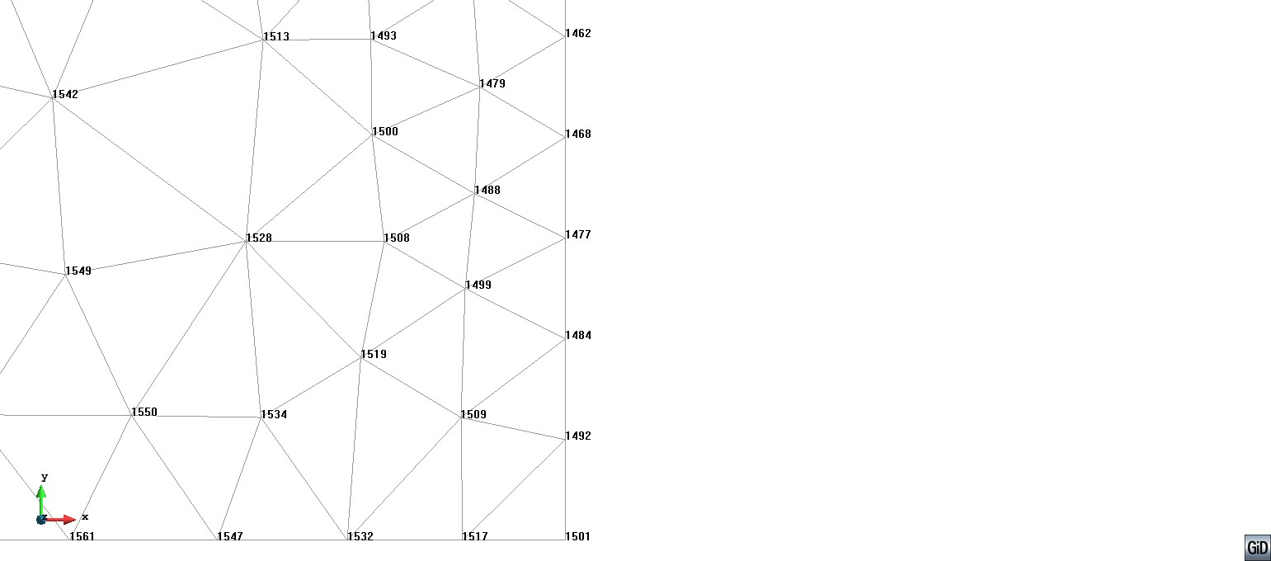
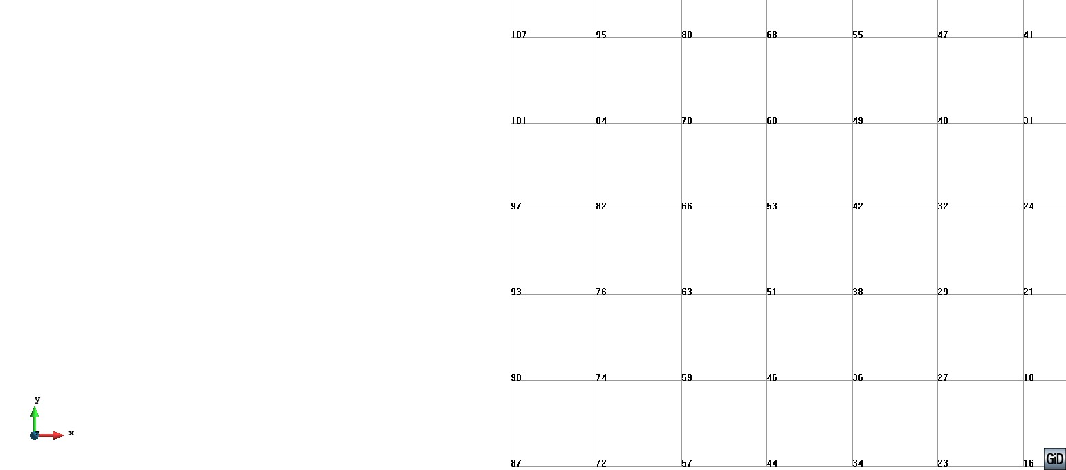
Kratos CFD + Kratos CSD coupling ⇒ non-matching grid map
Mapping algorithm for a matching grid
⇒ each fluid node is linked to the closest 2 structural nodes (for this case weigths 1 and 0)
1
0
1
0
Nodes in fluid mesh
1
Nodes in structure mesh
0
1
0
1
0
1

Slide 46
Kratos CFD + Kratos CSD coupling ⇒ non-matching grid map
Mapping algorithm for a matching grid
⇒ each fluid node is linked to the closest 2 structural nodes (for this case weights 1.0 or 0.0)
Mapping algorithm for a non-matching grid
⇒ each fluid node is linked to the closest 2 structural nodes (for this case weights take values from the [0,1] interval)
Fluid Node ID StructNode1 ID StructNode2 ID StructNode1 weight StructNode2 weight
…
1421 146 138 1.0 0.0
1432 138 146 1.0 0.0
1438 129 122 1.0 0.0
1446 122 129 1.0 0.0
1452 114 107 1.0 0.0
1462 107 114 1.0 0.0
1468 101 97 1.0 0.0
1477 97 93 1.0 0.0
1484 93 97 1.0 0.0
1492 90 87 1.0 0.0
1501 87 90 1.0 0.0
Fluid Node ID StructNode1 ID StructNode2 ID StructNode1 weight StructNode2 weight
…
1421 18 20 0.984 0.016
1432 18 15 0.714 0.286
1438 15 18 0.587 0.413
1446 15 18 0.889 0.111
1452 15 13 0.81 0.19
1462 15 13 0.508 0.492
1468 13 15 0.794 0.206
1477 13 10 0.905 0.095
1484 13 10 0.603 0.397
1492 10 13 0.698 0.302
1501 10 13 1.0 0.0

Slide 47
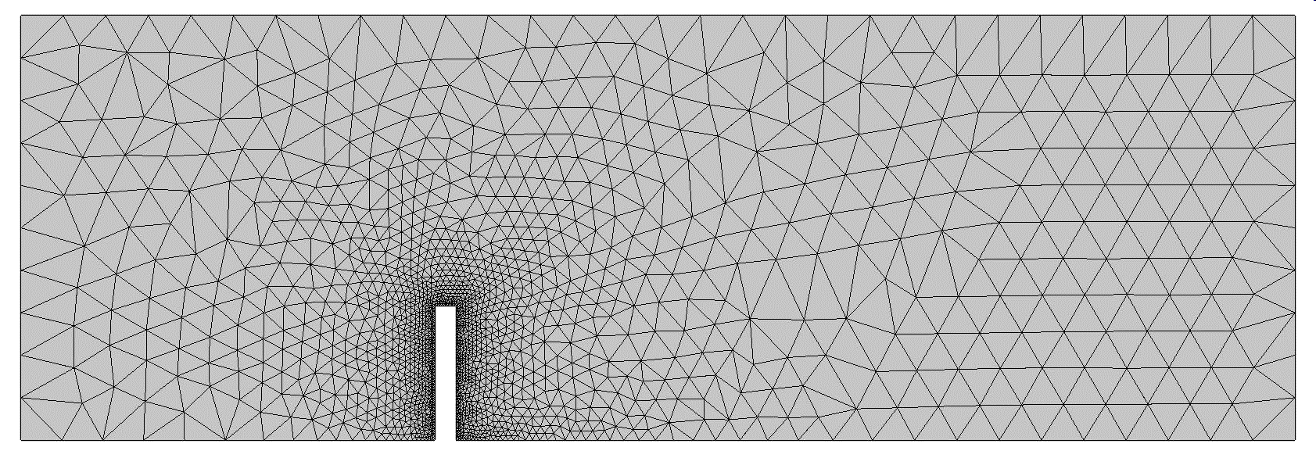
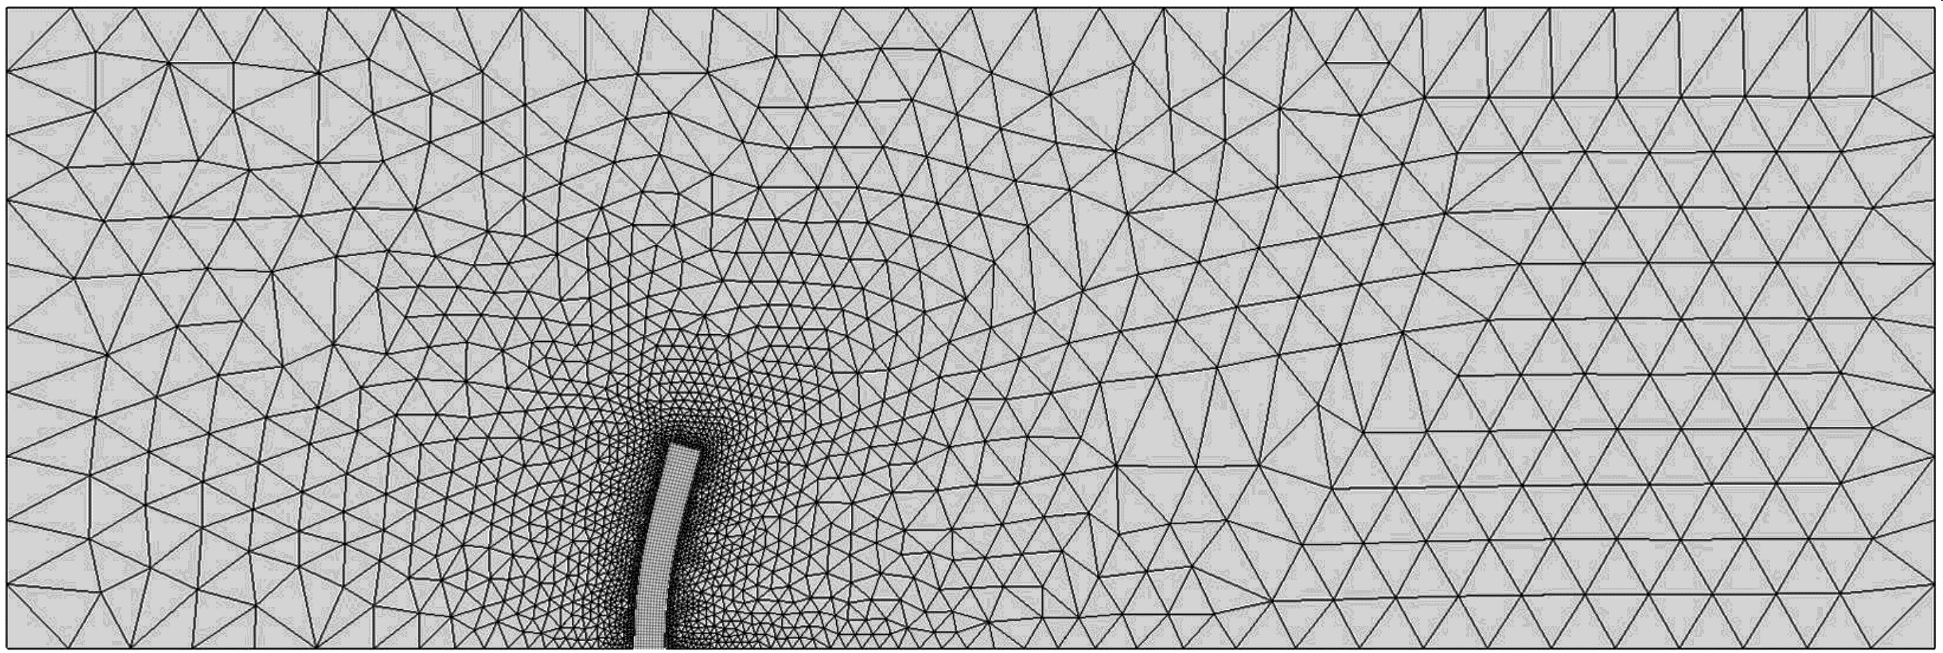
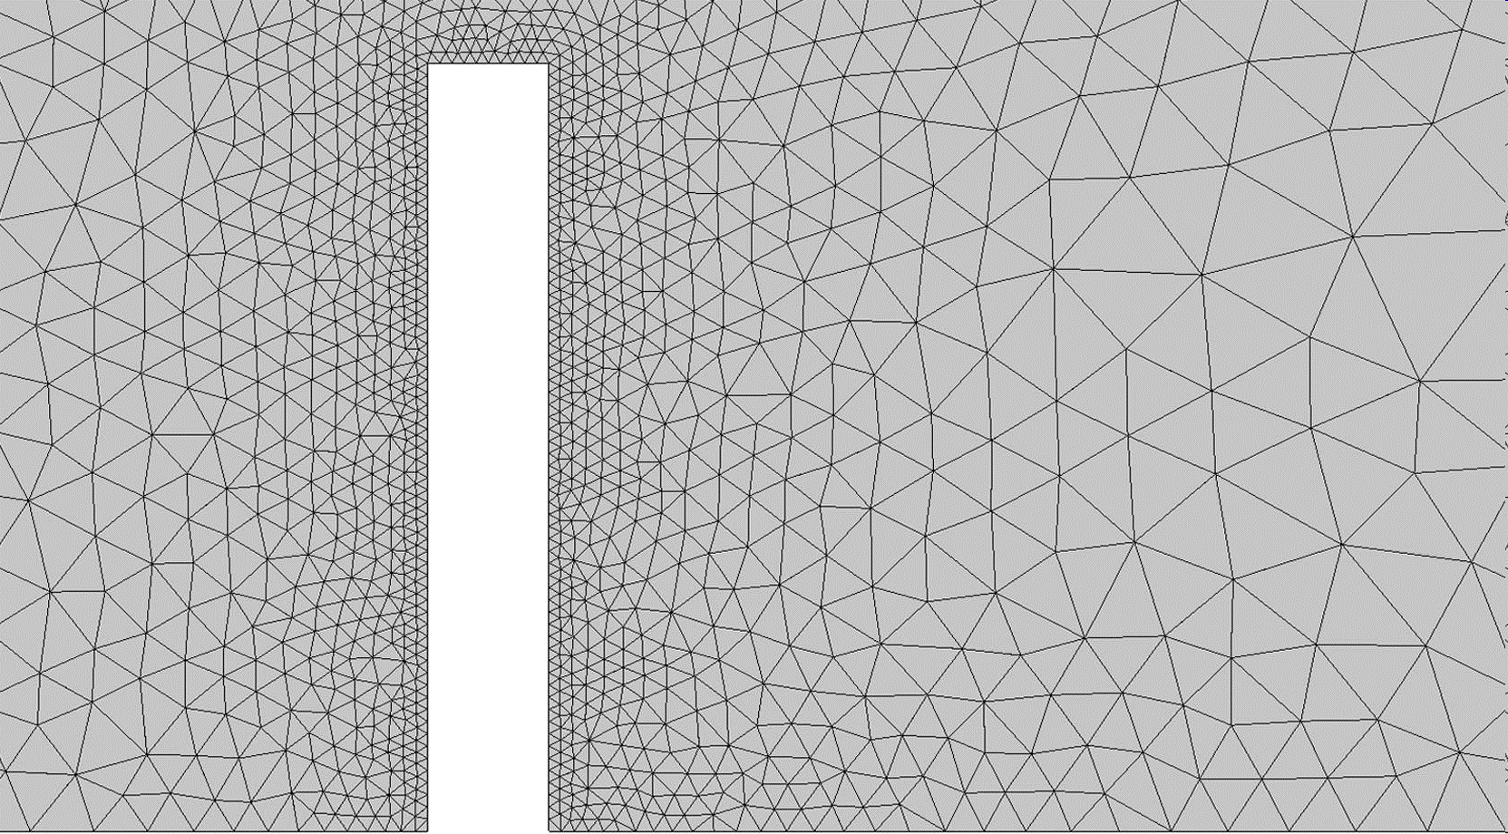
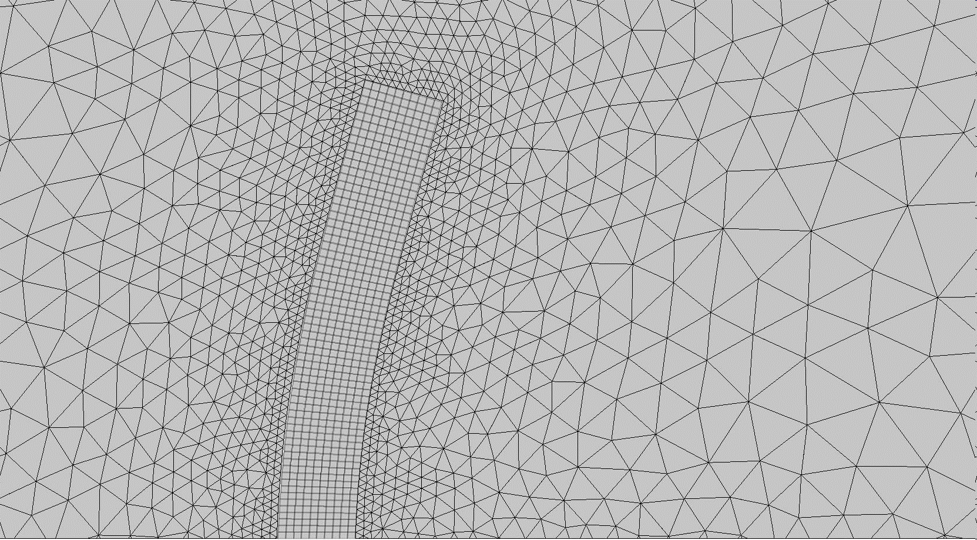
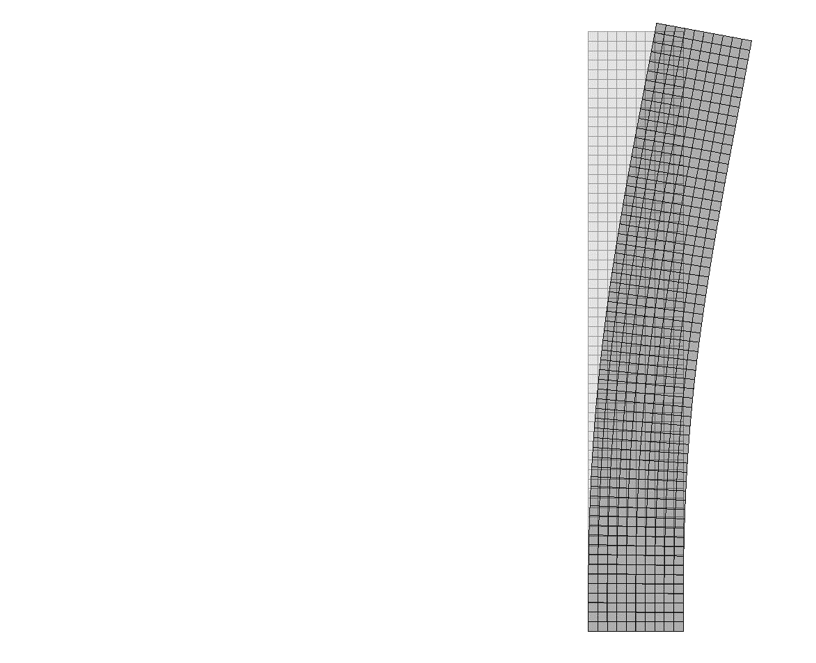
The goal ⇒ to you get familiar with the crucial components of CWSI
Pure CFD
One-Way Coupling
Two-Way Coupling
CFD
CFD
FSI = CFD + CSD
Achieved ✓
CSD
H
H
M
d
M
t
H
M
t
t
t
t
t
t
t
t
t
t
t
t
n-1
n
n+1
n+2
n-1
n
n+1
n+2
n-1
n
n+1
n+2
solve F
solve F
solve F
solve F
solve F
solve F
solve F
solve F
solve F
solve S
solve S
solve S
solve S
solve S
solve S

Slide 48
ADDITIONAL NOTES AND REMARKS

Slide 49
When using a simplified (2D) setup of a skyscraper (3D)…
Real case / setup
Numerical wind-tunnel setup
d
d
V = 50 m/s
h = 600m
Vertical cut along
T
M
Horizontal cut along
assume h/d =10
square cross section
F_{D}

Slide 50
…be aware of the consequences of dimensional reduction
2D setups…
…actually corresponding to:
Horizontal cut along
F_{D}
Aiming to correspond to
the 3D setup
F_{L}
These are not the same !?!
Vertical cut along
T
M

Slide 51
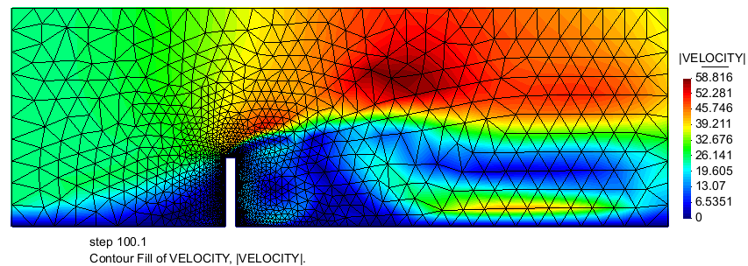
…be aware of the consequences due to modeling aspects („disclaimer“)
Horizontal cut along
F_{D}
F_{L}
Vertical cut along
T
M
We are here running (mostly) 2D simulations of an inherently 3D physical phenomenon ⇒ recall that turbulence is a 3D phenomenon
Also large 3D phenomena in flow field are not captured, like e.g. „end effects“, „flow around sides“, …
Concerning turbulence: RANS model for 2D or running the LES(-type) simulations in 3D
Methodology, presented components and workflow are nonetheless valid
Presented tutorials are adequate for educational and prototyping purposes (limits the computational necessities: hardware, time, etc!)

Slide 52
OUTLOOK

Slide 53
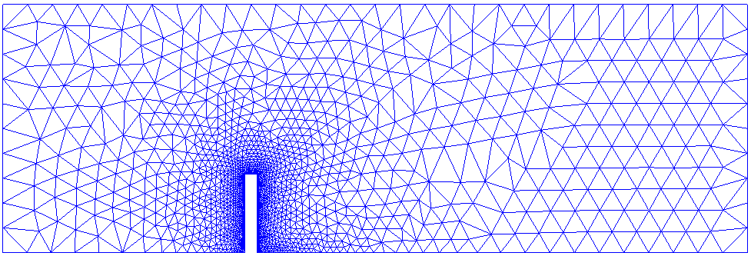
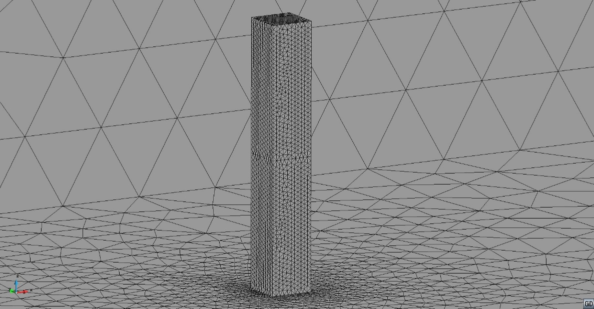
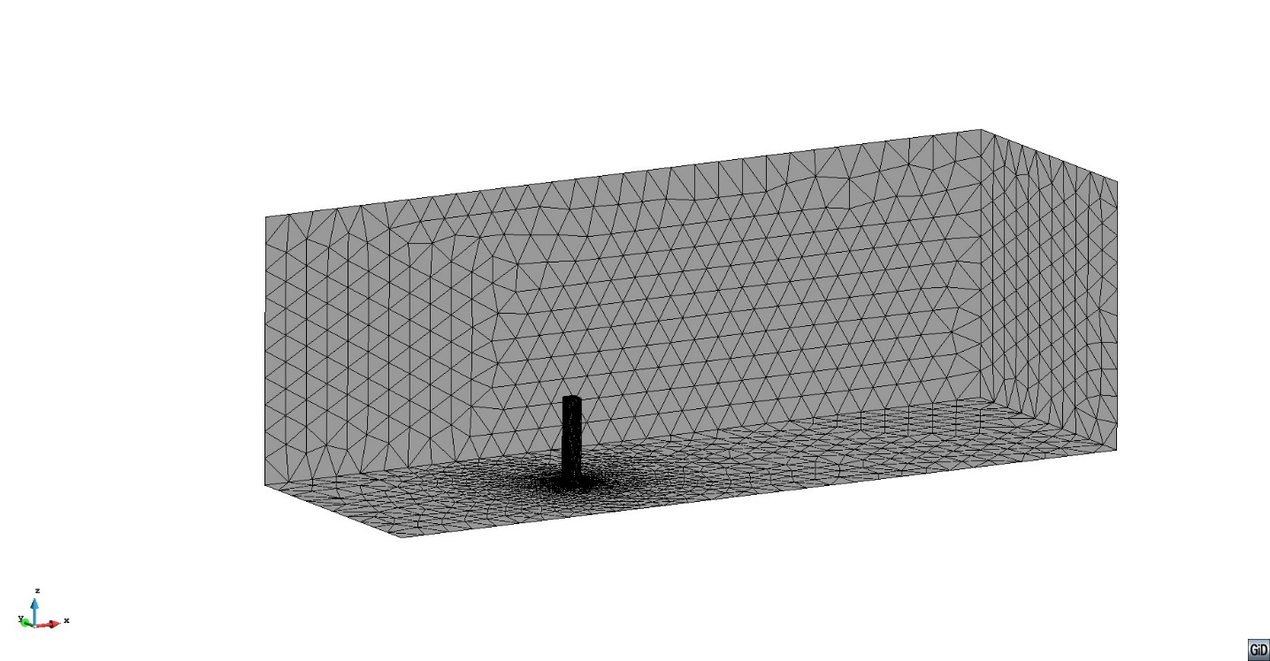
Advanced topics: FSI in 3D & respective challenges ⇒ for e.g w.r.t. mapping…
How to map to a structure modeled and discretized by e.g. beam elements (dimensional reduction!)? → several application cases in wind engineering: bridges, towers, skyscrapers, wind turbine blades, …
CFD – 2D
CSD - beam
?!
CFD – 3D

